Slide 1
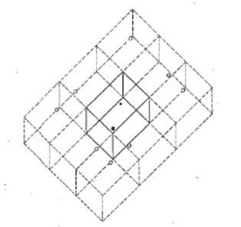
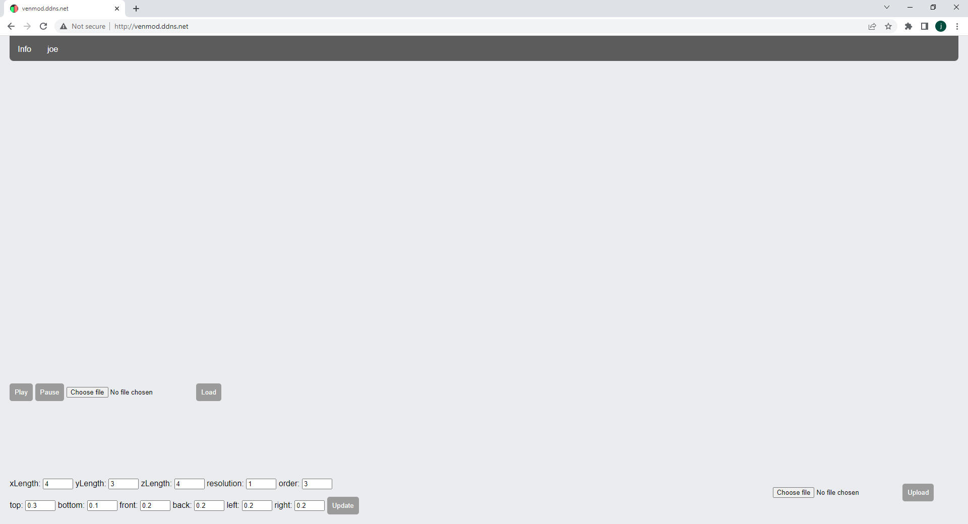
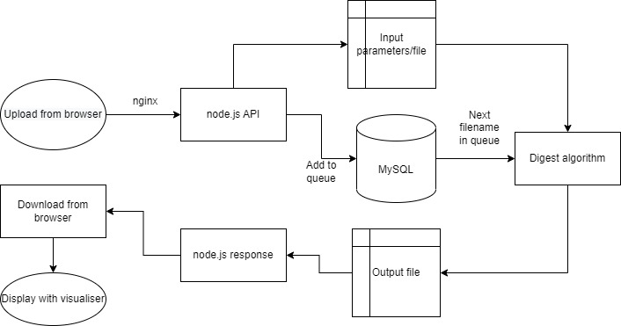
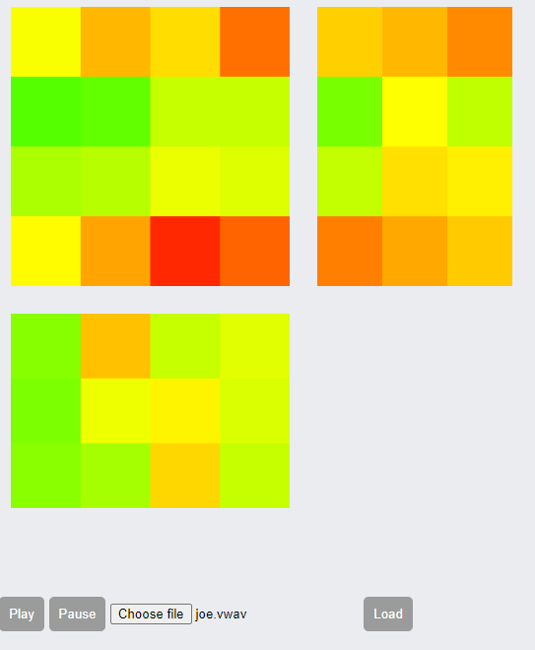
Visualising Audio in an Enclosed Reverberant Space
Joe Davison – u1958945@unimail.hud.ac.uk
A cloud processing system for calculating and visualising reverberation in an enclosed space.
This system allows a user to upload a 16 bit stereo wav file and calculates the correlation between the original audio and the resulting audio at multiple points throughout room.
The user can then download a file which contains the reverberated audio at a set listening point, as well as the correlation data for all points, which can then be played via an in browser visualiser.
Web-based
The idea behind this project was to provide a simple and free service to audio engineers which allows them to get a greater understanding of a venue they might not have other equipment to measure.
To provide that service I have chosen to host a public website using node.js, the website both serves as a place to upload audio files for processing as well as being the visualiser for playing files.
Simulation algorithm
The system calculates reflections by getting delay times using the distance from the speaker to a virtual point representing the path the ray takes as a straight line going through the walls.
It also calculates the total absorption of each wall by calculating the total count of and also which walls the ray passes through.
System overview
Visualiser
The visualiser represents the room as a net, each point in one of the cross sectional views is the average of the correlation at the points behind it going into the room.
GPU acceleration
To accelerate the simulation process GPU processing is used to parallelise the calculations for each sample of each ray.
Using GPU processing speeds up calculation for each point by about 30x-40x.
The Nvidia Cuda compiler (nvcc) was used along with C++ to program the simulation algorithm.
SQL ticketing system
Due to the length of time the calculations take, a queueing system is needed to sequence incoming requests. To do this the system uses a SQL database which tells both the digest algorithm and the node.js server who has a process order and whether it has been completed.

